Slide 1
Understanding Your Credit Report
“Mortgage Meltdown”
Credit scoring (FICO)
Annual Percentage Rate
Social Security Numbers
Adjustable Rate Mortgages
Divorce
Cosigning Situation
Identity Theft

Slide 2
Mortgage Meltdown
Foreclosure at all time high
Obtaining credit is increasingly difficult
Banks are using higher (FICO) credit scores to qualify people
Government putting higher restrictions on lenders lending money (Higher APR standards)

Slide 3
What is a Credit Score (FICO)?
Mathematical equation (number) between 300-850 that gives a lender a snapshot in time to help them decide whether or not they are going to loan you the money and how likely you are to pay them back.

Slide 4
Annual Percentage Rate
Annual Percentage Rate (APR)- Yearly interest of a loan taking into account one-time fees and standardizing the way the rate is expressed. In other words the APR is the total cost of credit to the consumer, expressed as an annual percentage of the amount of credit granted.

Slide 5
Regulation Z Changes (APR)
TIL must be mailed within 3 business days.
No payment for fees for services accepted until after 4th business day
Cannot close loan for 7 business days after the initial disclosure
If APR changes by .125% from original disclosures must re-disclose and time starts over again.

Slide 6
Social Security Numbers
Social Security Numbers first were issued in November 24, 1936. The first person receive the card was John David Sweeney, Jr. The person with the lowest number was Grace D. Owen with the #001-01-0001.
Original purpose was to track individuals account in Social Security Administration
Now used for tax purposes. All individuals at birth get SS#.
There is no law that requires a U.S. citizen to obtain a SS# to work.
Before 1973, SS# were issued at selected post offices. Now come from a central location (Baltimore, MD)

Slide 7
Structure of Social Security Number
Numbers start from Northeast to Southwest including US territories.
First 3 numbers (area number). Based on zip code on the application. Missouri:486-500; Illinois:318-361.
Next 2 represents group number. Used for orderly distribution. Odd 01-09; Even 10-98; Even 02-08.
Last 4 numbers represent serial numbers 0001-9999.
Numbers not used: 000-00-0000; numbers 666-66-6666 and 987-65-4320 to 987-65-4329.

Slide 8
10 Myths about Credit Report
“Close out accounts with zero balances.”
“Shopping for the best rate will hurt my score.”
“If I filed bankruptcy I will not be able to get a home or credit.”
“I have no credit on the credit report, therefore I have no credit.”
“You can hurt your score by checking your own credit report.”

Slide 9
10 Myths about Credit Report
“You don’t have to use credit to get a good score.”
“You have to pay interest to have a good credit score.”
“Adding 100 word statement can help the credit score in case of dispute.”
“Closed accounts should read “closed by consumer” or these accounts will hurt the score.”
“Credit counseling is worst than bankruptcy.”

Slide 10
What FICO score ignores?
Your race, color, religion, age, national origin, sex or marital status
Your salary, occupation, title, date of employment or employment history
Where you live
Any interest rate being charged
Any items being reported as child/family support or rental agreements
Certain inquires
Any information not found in your credit report (# of children, etc)
Any information that is not proven to be predictive of future credit performance

Slide 12
Payment History (35%)
Payment information on many accounts
Public Records and Collection Items
Details on late or missed payments
How many accounts show no late payments.
Notes:
More than half of Americans don’t have a single late payment on their credit reports. Only 3 in 10 have ever gone 60 days or more overdue in the past 7 years.
Score focuses on 3 factors:
Recency- how recently the borrower got into trouble. The more time passed the less the problem affects the score.
Frequency- the more the late payment occurs the more it affects the score
Severity- “Heirarchy of badness”. The worst the bad mark the more it affects the score

Slide 13
Amounts Owed (30%)
The amount owed on all accounts
Percentage of balances owed/ credit limit
Showing balances on different types of accounts
How many accounts have balances
How much toward credit cards
How much you owe on installment loans
Notes:
Most Americans use less than 30% of their available credit limits. 1 in 7 uses 80% or more of available limits

Slide 14
Length of Credit History (15%)
The average age of your credit accounts
How long specific credit accounts have been established
How long has it been since you used certain accounts
Notes:
The average American’s oldest account has been established for about 14 years. 1 in 4 has an account that ‘s been established for 20 years or more

Slide 15
Credit Usage (10%)
What kind of credit accounts do you have and how many of each (Installment, Mortgage and Revolving)
Installment- Bills that have ending payment dates (car loan and student loans)
Revolving- Bills that have no ending payment date (credit cards or home equity loans)
Mortgage- Money that is used to purchase a home.
Notes:
To get the highest score you need to have both revolving and installment debt.
Major credit cards such as Mastercard or Visa are better than the department store or finance company credit card due more stringent requirements for those cards to be obtained.
The average American has 13 credit accounts showing on their credit report, including 9 credit cards and 4 installment loans

Slide 16
New Credit (10%)
How many new accounts you’ve opened
How much time has passed since you have applied for credit
How many recent requests for credit you have made recently
How much time has passed since you opened a new account
Notes:
The average American has not opened an account in 20 months

Slide 17
Your Credit Score Card
Good Credit
Number of Accounts
Age of the Accounts
Age of the Youngest Account
Troubled Credit
Presence of Public Record
Worst Delinquency
The information from these items allow FICO to segment you into 1 of 10 groups
Notes:
Grouping people this way is suppose to enhance the formula’s predictive power. The theory is that the same behavior in different borrowers can mean different things. Someone with a troubled credit history who suddenly opens a slew of accounts, for example, might be seen as a much greater risk that someone with a long, clean history.
People move up and down between these different scorecards.

Slide 18
Delinquency Rates By FICO SCORE

Slide 19
Credit Bureaus
Equifax : 1-800-216-1102 www.equifax.com
Trans Union: 1-800-888-4213 www.transunion.com
Experian: 1-888-397-3742 www.experian.com
Free Yearly Credit Report:
www.annualcreditreport.com

Slide 20
Your Rights with the Credit Bureau
The right to have your dispute investigated
The right to have erroneous information corrected
The right to have a written response of the credit bureaus findings
The right to have a 100 word statement included in your file
The right to sue

Slide 21
Internet/Identity Theft Scams
Usage of someone’s personal information without their permission.
These crimes can range from stealing credit card number to obtaining information for use to get various documentation.
Identity theft is usually done wholesale.
Victims spend between 300 to 600 hours trying to correct the various problems caused by identity theft.
“New account” theft cost companies on average $10,200 per victim.
Average out-of-pocket for a victim is $1200.

Slide 22
Adjustable Rate Mortgage (How It Works)
Three things in an adjustable rate that you need to know:
Initial Rate (Your initial Start Rate)
Margin (Calculated change in Payment)
Index (Usually a Treasury Bill Rate)
Rate Cap (How high or low the rate can go during a period of time)

Slide 23
Internet/Identity Theft Scams
Mystery Shopper Scam
Hit Man Scam
Million Dollar Scam
Grandparents Scam
Military Wheels
Jury Scam
Border Bust
FBI Scam
Have something to sale scam

Slide 24
How to reduce your exposure to Identity Theft?
Buy a shredder
Get a locking mailbox
Protect your outgoing mail
Keep track of your receipts
Keep financial documents under lock and key
Get stingy with your social security number
Know what is in your wallet. Never keep Social Security Card in your wallet

Slide 25
How to reduce your exposure to Identity Theft?
Don’t let your debit or credit card out of your sight
Opt out of solicitations for credit cards
Don’t use cell phone or cordless phone to talk about financial matters
Monitor your yearly Social Security and credit card statements along with your credit report
Ask companies about their paper shredding policies

Slide 26
What if you are a victim of identity theft?
Keep good notes of everyone you talked to
Contact credit bureaus and creditors by phone and then follow up in writing (certified mail with return receipt requested
Contact police
Contact bank and check verification companies
Contact the collection agencies
Get legal help
Don’t give up and be persistent!

Slide 27
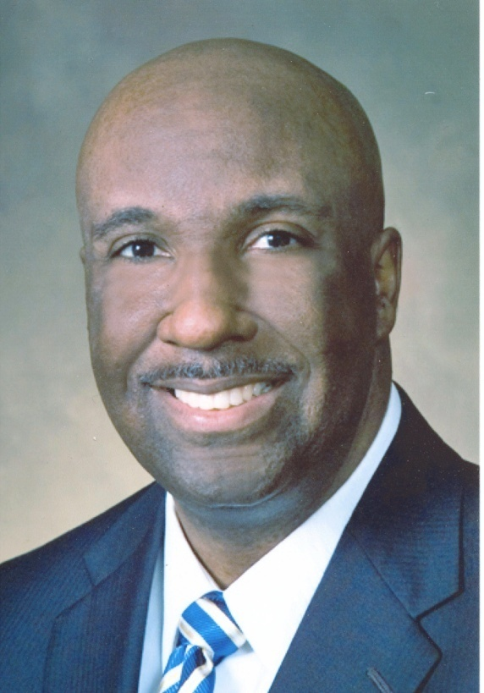
Contact Information
Patrick I. Gaydon
MetLife Home Loans
55 Westport Plaza Suite 755
St. Louis, Missouri 63146
314-283-7550 ©
314-275-1411 (o)
pgaydon@metlife.com or japp04@sbcglobal.net

